Slide 1
Cuban Missile Crisis
Primary Document Analysis

Slide 2
Analyze the political cartoon and photograph on the next slide.
For the cartoon, answer the following:
1. What action is taking place in the cartoon?
2. Explain how the words in the cartoon clarify the symbols.
3. Explain the message of the cartoon.
4. Who would agree or disagree with the cartoon’s message? Why?
For the photo, answer the following:
1. Take a few minutes to look closely at the photo. What is the person in the photo doing?
3. What factual information is contained in the photo?
4. What can you infer from the photo?
5. What more do you need to know about the photo?

Slide 3
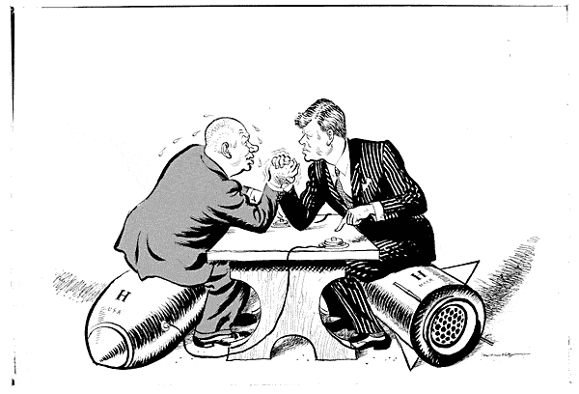
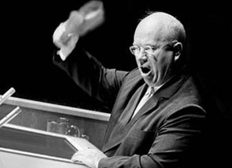
“OK Mr. President, let’s talk”
“We will bury you”

Slide 4
1. What do you think the photograph and the cartoon say about the concept of “liberty” during this time?
2. The photograph is a fake. It is a widely distributed fake. There are no pictures of Khrushchev with his shoe. Does this change your previous reasoning? Why?

Slide 5
Read the quotes on the next slide and answer these three questions:
1. What factual information is contained in the quotes?
2. What can you infer from the quotes?
3. What is the tone of the speaker? What does this tone say about the issues surrounding the Cold War?

Slide 6
“If you don’t like us, don’t accept our invitations and don’t invite us to come to see you. Whether you like it or not, history is on our side. We will bury you.” Nikita Khrushchev, November 18, 1956
“America has been in existence for 150 years and this is the level she has reached. We have existed not quite 42 years and in another seven years we will be on the same level as America. When we catch you up, in passing you by, we will wave to you.” Nikita Khrushchev, July 24, 1959

