Slide 1

How Higher Ed Can Emerge Stronger Post-Pandemic
Administrative Efficiencies Enhance the Mission
DATA PRIVACY LANDSCAPE OVERVIEW
Southern Regional Education Board & Huron Webinar Series
Wednesday, April 14, 2021

Slide 2
Agenda
Introductions
Overview of organizational efficiency and effectiveness
Case studies
Considerations moving forward
Q&A / group discussion

Slide 3
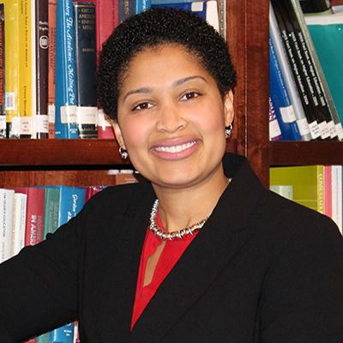
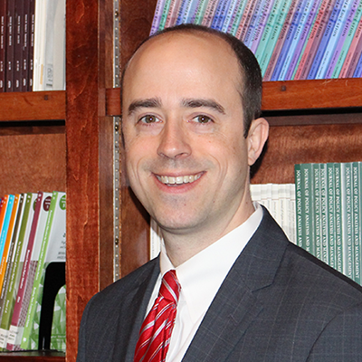
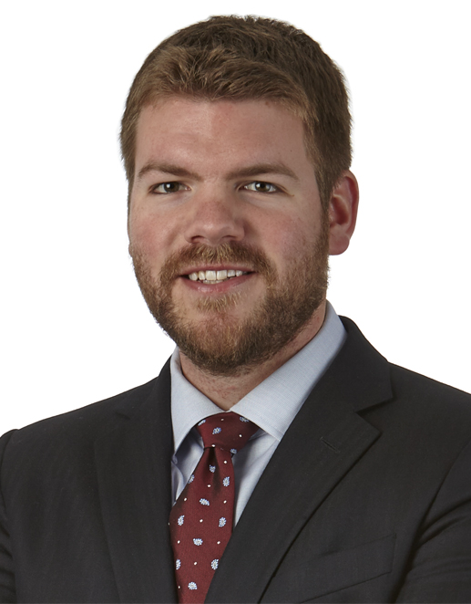
Introductions: Today’s Presenters
Dr. Juanita Hicks
Vice Chancellor for
Human Resources,
University System of Georgia
Dr. John M. Fuchko, III
Vice Chancellor for Organizational Effectiveness, University System of Georgia
Chris Byrne
Director, Huron

Slide 4
Organizational efficiency and effectiveness overview

Slide 5



Impetus for Efficiency / Effectiveness Initiatives
Long-Standing Trends
Present Crisis
Lasting Outcomes
Demographic declines
Rising discount rates
Declining NTR
Cost reduction efforts
Shared services
Portfolio optimization
Delivery innovation
Diversity, equity, inclusion
Consolidation/M&A
Executive pay cuts
Furloughs and layoffs
Room and board refunds
Enrollment risk
Remote instruction
Remote work
Pricing discounts
Reduced athletics
Reputational risk
Organizational restructuring
Work from home
Classroom and facilities
HyFlex delivery
Academic quality
Growth strategy
Geographic reach
Competitive positioning
Pricing innovation

Slide 6
Poll Question #1
Which administrative efficiency efforts have been most successfully implemented at your institution?
Improved procurement / pricing practices
Outsourcing selected functions
Organizational restructuring / centralization
None of the above

Slide 7
What is Organizational Effectiveness?
Effectiveness focuses on the ability to realize institutional outcomes and outputs.
Effectiveness is the
ability of an organization to achieve its strategic objectives in a
sustained way.
Accelerating
Results
Reducing
Waste
COSTS
Efficiency refers to the resources required to achieve those results.
OUTPUTS / OUTCOMES
7
Notes:
1.30
Paul introduced the ideas of efficiency and effectiveness. These two concepts are interrelated, but I think it can be useful to distinguish them.
% Effectiveness refers to the ability of an organization to achieve strategic objectives in a sustained way. This is about results
Increasing effectiveness accelerates or elevates the achievement of those results.
% Efficiency is the ability of an organization to perform its activities with less resources.
This may mean achieving scale or reducing the waste in business processes or activities.
The institution reduces the costs per unit of output.
% Increased effectiveness does not always mean lower costs, however, these concepts are not completely independent.
A stronger focus on efficiency can free resources to invest in strategic priorities.
In what we have called the “triage” stage of response to COVID-19, this is what many institution’s needed to focus on in order to close the looming financial gap.
Only focusing on efficiency, over the long term, can lead to “cutting to the bone.”
It’s hard to determine when efficiency is done.
While not always the case, a focus on effectiveness often does result in reduced time, effort, and costs. This occurs through:
Better alignment of investment with output and outcomes
Faster decision making, less waiting
Less time/effort meeting and moving information around
Less rework and duplication of institutional effort
Full utilization of assets, skills, and knowledge
Effectiveness often involves more fundamental, transformative changes.
What are we doing?
How do we get things done?

Slide 8

Org. Effectiveness and the Operating Model
Achieving effectiveness requires thinking of the entire operating model of the institution.
How we define and organize work and accountability.
Goals
& Metrics
How we define priorities, make decisions, allocate resources and coordinate action.
Organizational
Structure
Leadership,
& Culture
Management
Processes
How we shape and model beliefs, behaviors and norms.
How we set objectives, define and measure success and create incentives.

Slide 9







Opportunity Enabled by Efficiency Initiatives
Selected Investment Areas
Scholarship and Financial Aid
Tenure Track Faculty
Community Engagement Initiatives
Other Strategic Opportunities
Research Investments
New Academic Programs
Deferred Maintenance
At a $100M institution that traditionally performs with a 1% operating margin, a comprehensive efficiency initiative could yield an additional $69M for investment in institutional priorities over 10 years.
Relative to status quo operations, a comprehensive efficiency improvement effort can surface material resources year-over-year for investment in institutional initiatives critical to ensuring long-term competitiveness.

Slide 10
CASE STUDIES

Slide 11
Case 1: Broad Org. Effectiveness Initiative (1 of 2)
Huron was recently engaged by a large research institution to assist in breaking down campus “silos” and creating a more centralized and efficient service delivery model.
ACTIONS TAKEN
Analyzed management structures (i.e., “spans and layers”)
Identified material number of managers with 3 or fewer direct reports
Examined extent of title inflation
Implemented controls for hiring, compensation and classification
Analyzed centralized vs. distributed effort across core administrative services (i.e. HR, Finance, IT)
Examined capital resource allocation and project prioritization
Goals
& Metrics
Organizational
Structure
Leadership,
& Culture
Management
Processes
Assessed siloed perspectives on institution’s success (i.e., school by school)
Implemented increased accountability measures for performance and stewardship of resources
Increased cross-campus collaboration
Examined sources and uses of funds
Analyzed “apples-to-apples” school- and campus-level financial performance
Examined administrative service level equity across the enterprise

Slide 12
Case 1: Broad Org. Effectiveness Initiative (2 of 2)
Huron was recently engaged by a large research institution to assist in breaking down campus “silos” and creating a more centralized and efficient service delivery model.
RESULTS ACHIEVED
Significant unit-by-unit restructuring
Permanently changed organizational structures
Annual personnel savings in excess of $25MM achieved
Goals
& Metrics
Improved position control
Increased appetite for shared administrative services
Fostered longer-term approach to institutional investment and success
Organizational
Structure
Leadership,
& Culture
Management
Processes
Weekly cross-campus leadership meetings
Enterprise view of institutional success
Improved accountability for campus and unit performance
Ongoing monitoring of financial performance
Improved insight into units’ financials
Organizational redesign efforts aimed at normalizing service levels

Slide 13



Case 2: Recent USG Initiatives
Initiative | Background / Summary | Outcomes
Centralization of Administrative Services | Highly distributed core administrative services contributed to high costs and inconsistent service levels USG sought to centralize HR, IT, and Business Manager (finance/budget) functions | Centrally managed, consistent and standardized services Reduced costs, and improved accountability and greater transparency into processes
Strategic Implementation Unit | Historically informal approach / structure for managing change of these and other major initiatives Opportunity to fully integrate project governance, project management, and change management under one unit | Dedicated unit to support effective implementation of material change initiatives (technology and other) Heavy focus on change management to ensure initiatives’ long-term success
Forward- Looking Initiatives | Recognition of need to focus on long-term employee pipeline and evolving workforce needs Future of work (i.e., remote) post-Covid Other | Proactive workforce planning / hiring pipeline to avoid under-resourcing Ensuring org structures and staffing levels reflect true business / service needs
Cost savings associated with these initiatives have been utilized for investment in strategic initiatives, such as new faculty hiring, strengthening core academic programs, student success efforts, and increased financial aid.

Slide 14
Case 3: Impact of an Efficiency Initiative
In 2015-2016, Huron partnered with a ~$1 billion research institution to identify opportunities to eliminate its recurring annual operating deficit of $15-20 million.
Challenge
“We are projecting a surplus for FY18… we have also had record breaking success in admissions, development, and rankings… What a difference two years makes! Thanks for all your help!”
- University President
Recurring Operating Deficits
Minimal or negative cash flows limited ability to invest in strategic initiatives and critical deferred maintenance needs
75
Discrete efficiency / effectiveness opportunities identified
Goal
Outcome
Identify Resources for Investment
Uncover and implement cost savings and revenue enhancement initiatives to eliminate recurring deficit, and enable investment in critical strategic endeavors
15 prioritized opportunities selected for implementation, with annual financial impact of $30MM+
Operating deficit eliminated, unleashing resources to invest in academics, research, aid, infrastructure, and other critical mission priorities; record admissions numbers and rankings improvement
$30 million
14

Slide 15
Poll Question #2
Do you believe that efficiency / effectiveness initiatives will be needed at your institution to strengthen its financial and competitive position?
Yes
No

Slide 16

MOVING FORWARD

Slide 17
“Building the Airplane as We Fly”
Improving organizational effectiveness does not require transforming the entire institution at once.
Get the Parts
Fly the Plane
Assigning ownership (publicly)
Be clear about decision authority
Sharing common, real-time information and data (dashboards)
Establishing regular cadences of communication
Hold people accountable (publicly)
Address and learn from issues
Capture and communicate lessons learned
Converge around themes/outcomes, not organization boundaries
Celebrate success
17
Notes:
Many of my client interactions for the past 6 months have included this phrase.
It’s the most available metaphor to convey our sense of urgency, lack of resources, and uncertainty.
While many university business officers may be ready for “transformative changes in core structures and operations” others may have to consider more incremental change.
The Operating model is a blueprint for effectiveness.
Improving organizational effectiveness does not require transforming the entire institution at once.
% Get the parts – There are ways to start to formalize accountability, share information in new ways, and communicate.
In each of these sections, I asked you to identify one component of your operating model that might need attention.
These could be “parts” for your plane.
% But also fly the plane – This has to be in practice.
Be ready to experiment.
Don’t give up too quicky—effectiveness practices often take time to stick.
A lot of my work involves change management, and I’ve found the most consistent theme behind that is “repetition.”
But don’t hold on if an experiment doesn’t work.

Slide 18
Join Us: Upcoming Sessions
Topic | Date
Enrollment Management and Strategy | April 28th
Ensuring Community Colleges Emerge Stronger | May 12th
Notes:
Huron looks forward to hosting additional sessions in coming weeks, on the more specialized topics outlined in the table below.

Slide 19
Question & Answer and
Group Discussion
Learn more: www.HuronConsultingGroup.com

