Slide 1
SREB’s Discussion with State Leaders on the Perkins V Comprehensive Local Needs Assessment
Wednesday, July 17, 2109

Slide 2
If states do not address the issues head-on,
businesses will find it ever harder to fil positions f or skilled and creative workers;
existing employment and wage gaps will grow, between those with secondary postsecondary credentials and those without;
overall workforce productivity will drop;
states will experience drops in workers’ earnings, resulting in stagnating or falling tax revenues;
more citizens will live in poverty and need to access public services; and
the quality of life and opportunities for individuals without sufficient education will decline.

Slide 3
Perkins V
funds CTE primarily in secondary schools, community and technical colleges, and area CTE schools;
aims to prepare youth and adults for postsecondary education and careers; and
emphasizes technical knowledge, employability skills and rigorous academic content.

Slide 4
Needs Assessment Components
Student Performance Data
Size, Scope and Quality
Labor Market Alignment
Programs of Study
Educator Recruitment, Retention and Training
Access and Equity

Slide 5



CTE State Leaders
Dr. Barbara Wall, State Director of Career, Technical and Agriculture Education – Georgia Department of Education.
Ms. Karla Tipton, Manager of the Data and Investment Branch – Kentucky Department of Education.
Ms. Angel Malone, State Director of Career and Technology Education – South Carolina Department of Education.

Slide 6
Georgia CTAE Perkins V CLNA & Local Application
SREB Webinar
Barbara M. Wall, Ed.D.
July& 17, 2019

Slide 7
Comprehensive Needs Assessment – What we know. . .
Greatest change under section 134 of Perkins V – local CNA
Perkins grant recipients – never required CNA; other federal grants have
All federal programs in GA except Perkins are aligned with the one CNA
Perkins reauthorizations provides opportunity to fully integrate CTAE into the existing Georgia CNA, thus allowing CTAE to have a seat at the table when LEAs are putting together their districts plans.
Throughout Perkins V – collaboration is key.

Slide 8
Georgia’s CTAE Charge for the CNA . . .
Under leadership of Superintendent Woods and Chief of Staff Jones, Georgia is moving from silos to collaborative aligned work.
What’s convenient for GaDOE vs what’s convenient for districts
Determine if the CTAE CNA can become part of the existing Georgia CNA to lesson the burden on local districts and to ensure that CTAE is at the table when district improvement plans are created.

Slide 9
Comprehensive Needs Assessment – What we’ve done so far . . .
Began collaborating with title programs that had created CNA already.
Began collaborating with IT Division at GaDOE about CNA.
Met with group of Local CTAE Directors about the CNA.
Developed rough draft of Local Application.
Assembled group of Local CTAE Directors with their Local Title Coordinators to continue planning the CNA. – some parts can be together; some separate – date of May 15 for Perkins & CTAE state grants vs date of July 30 for Federal Title Funds
Conducted Sip & See and Gallery Walk at Summer GACTE Conference

Slide 10
Georgia’s System of Continuous Improvement

Slide 11
Comprehensive
Local Needs
Assessment
For the LEA to keep & use to inform the local application
The Comprehensive Local Needs Assessment (CLNA) is a powerful opportunity through the ESSA CLIP for the LEA to engage stakeholders to take an in-depth look of the system’s CTAE offerings and how they align to high wage and high skill local in-demand industry occupations.
The CLNA process is data-driven and allows the LEA:
To analyze, identify, and quantify any disparities or gaps between any subgroup of CTAE concentrators from their comparison group on core performance indicators.
To identify the CTAE pathways that are sufficient in size, scope and quality to meet the needs of ALL students.
To access the current and future CTAE programs, and programs of study.
To evaluate the LEA’s current and future recruitment, retention and professional development of CTAE teachers.
To evaluate the progress in providing equal access to all students including strategies to overcome barriers.
To identify overarching needs and any root causes that need to be addressed.

Slide 12
Local Application
LEA uses CLNA to complete local application to submit to GaDOE for Perkins funding.
The results of the CLNA drives the local application by strengthening data driven decisions by the LEA on spending Federal Perkins funds.
Each eligible LEA must submit a local application to be eligible for funding.
The local application will include:
A description of the results of the CLNA.
Information on CTAE course offerings and activities to be provided with Perkins Funds.
A description of career guidance activities, improvement of academic skills, activities to prepare special pops for high skill, high wage, in-demand occupations, equal-access to All students, work-based learning opportunities, dual enrollment, professional learning, and address disparities or gaps in performance of students.

Slide 13
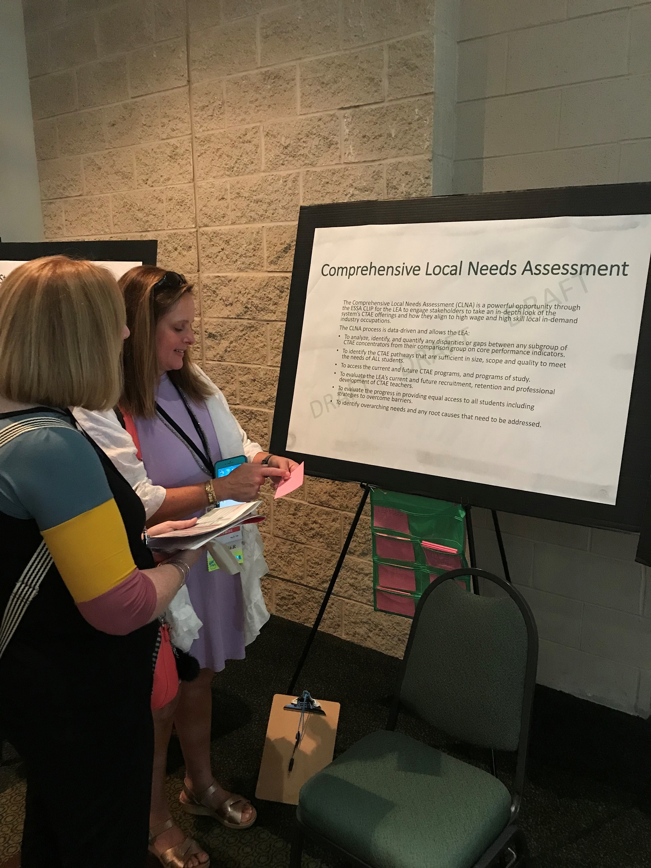
Sip & See and Gallery Walk
Questions? Concerns?
For the LEA to keep & use to inform the local application

Slide 14
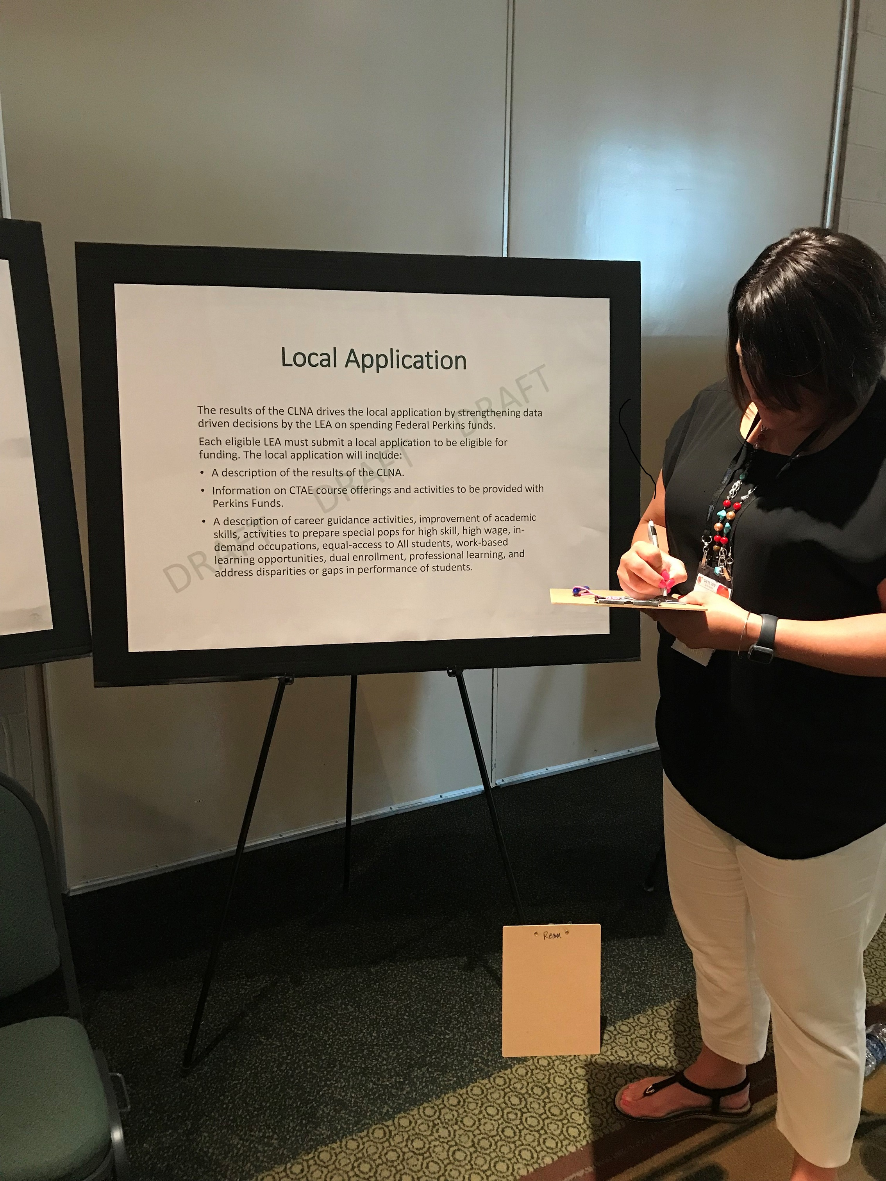
Sip & See and Gallery Walk
Questions? Concerns?
LEA uses CLNA to complete local application to submit to GaDOE for Perkins funding.

Slide 15
Perkins V Core Indicators (new, non-trad participant dropped, new but on ESSA,)
1S1 - Four-Year Graduation Rate
1S2 - Extended Graduation Rate
2S1 - Academic Proficiency in Reading/Language Arts
2S2 - Academic Proficiency in Mathematics
2S3 - Academic Proficiency in Science (biology)
3S1 - Post-Program Placement
4S1 - Non-traditional Program Concentration
5S3 - Participated in Work-Based Learning
5S4 - CTAE Pathway Completers
5S5 - End of Pathway Assessment (EOPA) (Technical Skill Attainment)

Slide 16
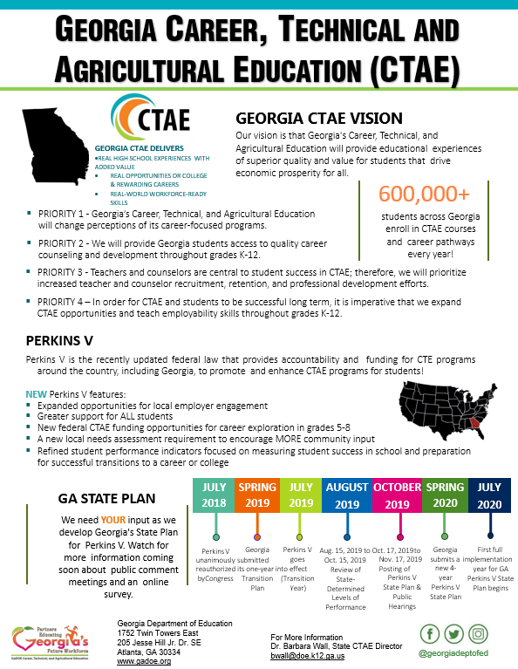

Slide 17
Tools to Help CTAE Deliver
Georgia Alignment Toolkit – resources for connecting education & business (training – Sept)
www.gadoe.org/Curriculum-Instruction-and-Assessment/CTAE/Documents/GaDOE-Alignment-Toolkit-Report.pdf
State-wide CTAE B & I Advisory Council – (accountability)
Educator Externship Opportunities (CTAERN: 121 FY 19)
Experiential Learning website (Ga Power) https://gaworkforce.org/explearning
Economic Development Educator Course Development & Pilot FY 20
New Equipment Grants – new facility nor modified facility required
GACTE Summer Conference: July 15-17, 2020 (W-F) - Athens

Slide 18
Comprehensive Needs Assessment – Next Steps. . .
Analyze input from GACTE Summer Conference
Finalize CNA
Finalize Local Application
Explore Streamlined CNA process
Post state-determined levels of performance for review (August 15-October 15, 2019)
GaDOE and CVIOG develop CLNA guidance document, related resources, & training to conduct effective & meaningful needs assessment process for FY20
Enhance Georgia Career Pipeline Tool with labor market data and technical assistance for FY 20 (CVIOG & GaDOE) http://gacareerpipeline.gadoe.org/
Have CVIOG Provide Labor Market Information Workshops for LEAs

Slide 19
Questions?
bwall@doe.k12.ga.us
404-387-1666

Slide 20
COMPREHENSIVE LOCAL NEEDS ASSESSMENT
Karla Tipton
Kentucky Department of Education
Office of Career and Technical Education
300 Sower Blvd.
Frankfort, KY 40601
502/564-4286

Slide 21
Who Do I Work With?
KCTCS Regional Service Areas
New Skills For Youth Partners
A Group of Districts/ATCs/Postsecondary Institutions
County Partnerships

Slide 22
Needs Assessment Tool
Each recipient group will complete the same document.
The document includes the 5 required questions.
Each of the 5 required questions has focus questions that links the information to the local application.
Each stakeholder group is required to sign the needs assessment tool.

Slide 23
Links to the Local Application
The results of the local needs assessment must drive local spending decisions.
The strengths and weaknesses identified in the local needs assessment should connect to the activities outlined in the local application.
Training for the local applications will be in the fall/early winter of 2019-2020.

Slide 24
Timelines
Each recipient of Perkins funds MUST notify OCTEST by September 15, 2019 on how they will do the comprehensive needs assessment—as part of a KCTCS Service Region, NSFY consortium, group of districts or as a county partnership.
Comprehensive Needs Assessments must be submitted by January 1, 2020.

Slide 25

Office of Career and Technical Education
Needs Assessment
#FUTUREREADYCTE

Slide 26
Vision & Mission for SC CTE
Vision:
All students graduate prepared for success in college, careers, and citizenship.
Mission:
To cultivate the development of a skilled workforce and a responsive workforce system that meets the needs of business and industry leading to sustainable growth, economic prosperity, and global competitiveness for South Carolina.
Notes:
To ensure that all CTE programs are addressing the needs of our mission and aligned to local, regional, and state labor market demands; thus building a pipeline of skilled workers for an ever responsive workforce.

Slide 27

Perkins V Local Needs Assessment
The new legislation presents a tremendous opportunity for retooling our state’s career and technical education programs
and scaling up promising practices to address equity and access to CTE for all students.
Notes:
The reauthorization of Perkins V contains a new requirement. Local recipients of Perkins funding must now complete a Local Needs Assessment which must be included in each local application. There are five requirements for the Local Comprehensive Needs Assessment:
• Evaluation of student performance by subgroup on Perkins core indicators.
• Description of the CTE programs offered (size, scope, quality and alignment).
• Evaluation of the progress toward implementing CTE programs and programs of study.
• Description of recruitment, retention and training for CTE educators and support professionals.
• Description of progress toward implementing equal access to CTE for all students.
The Local Needs Assessment should be part of an ongoing performance management cycle that includes both longer range performance goals and shorter-cycle implementation targets.
The Local Needs Assessment must be completed every two years with a review of progress during the succeeding year. The assessment (or review) must be completed prior to the completion of the grant application and must be submitted with the application.

Slide 28
Identifying Measures for CTE Program Review
Process measures:
Quantitative measures:
Qualitative measures:
“Conduct ongoing analysis of economic and workforce trends to identify regional Programs of Study to be created, expanded, or discontinued.”
“Proportion of students participating in experiential learning opportunities (lab work, co-ops, simulated workplace, mentorships, internships, pre- apprenticeships, apprenticeships).”
“How do we involve the community, and business and industry in your program?”

Slide 29

Developing a Comprehensive Needs Assessment
Identify Planning Team (shareholders).
Identify data sources (shareholders engage in a review of focused data).
Analyze the disaggregated data.
Identify areas of growth and strength (what is working).
Identify areas of opportunity (what requires improvement).
Prioritize opportunities.
#FUTUREREADYCTE
Notes:
Strengths and weaknesses of the state, school and/or LEA can be determined. Understanding the context and constraints of the school and/or LEA can be evaluated. Perform a root-cause analysis and develop an improvement plan. Overall the process of completing a local needs assessment is about making more informed decisions about CTE programming, using data to ensure your local programs help create success for students and employers.

Slide 30
Developing a Comprehensive Needs Assessment
Statewide top 5 industry sectors with 10 year job growth projection
Local and regional top industry sectors with 10 year job growth projection
Assessment of Program quality
Statewide performance goals
#FUTUREREADYCTE
Notes:
Strengths and weaknesses of the state, school and/or LEA can be determined. Understanding the context and constraints of the school and/or LEA can be evaluated. Perform a root-cause analysis and develop an improvement plan. Overall the process of completing a local needs assessment is about making more informed decisions about CTE programming, using data to ensure your local programs help create success for students and employers.

Slide 31
State Level Labor Market
Quantified Sector Based Demand of 10 year growth projection
Business and IT Services
Health Care
Transportation, Logistics & Wholesale Trade
Construction
Diversified Manufacturing

Slide 32
Labor market
Ensuring the programs are aligned to the needs of:
The Local Community
The Region
The State

Slide 33
Performance Measures
Quantitative and Qualitative deep dive into the data:
Gaps analysis
Disaggregate review of ESSA Subgroups
Who are we serving and why?

Slide 34
Programs of Study
Leading to:
Completer status
Postsecondary
Industry or Nationally recognized Certification or Credential
Notes:
o Program quality
▪ Leading to completion with 3 or more courses
▪ Leading to industry credential
▪ Leading to dual credit

Slide 35
Quality Review Measures (QRM)
An Evaluation of Career and Technical Education Programs
The quality review measures provide guidance and direction to school districts and multidistrict career centers in establishing, maintaining, and evaluating career and technical education programs.

Slide 36
Contact Information
Angel H. Malone, Director
amalone@ed.sc.gov
803-734-8412

Slide 37
Questions or Technical Assistance
Contact:
Dale Winkler, Ed.D.
Vice President – SREB
Dale.Winkler@SREB.org
404-879-5529

