Slide 1
Understanding Ourselves in the Equity Access Equation
Engaging in the equity imperative
Mark Williams, Ph.D.
Assistant Professor, Business Studies
The Community College of Baltimore County
Mark Williams, Ph.D.

Slide 2
What is at the center of Equity discussion?
It starts with courageous conversations-at all levels of the institution.
Engages those who wont talk
Sustains the conversation when it gets uncomfortable or diverted
Deepens the conversation to the point where authentic understanding and meaningful actions occur
The Center for Urban Education “frames inequity as a problem of practice rather than a problem with students, emphasizing the responsibility of higher education institutions, faculty, staff, and leaders to eliminate disparities in educational outcomes and create equity for all students.”

Slide 3
Student Faculty Interactions
The purpose, depth and quality of student-faculty interactions has been found to be more important (Pascarella & Terenzini, 2005).
For students of color and first generation college students, the positive effects of faculty-student interactions are particularly strong (Lundberg & Schreiner, 2004).
Benefits
Persistence toward degree completion
Increased persistence and retention rates
Development of leadership
Sense of worth and validation
Promote student engagement
Qualities of a high-quality faculty interaction (Alderman 2008)
Faculty members were approachable and personable
Faculty members had enthusiasm and passion for their work
Faculty cared about students personally
Faculty members served as role models and mentors

Slide 4
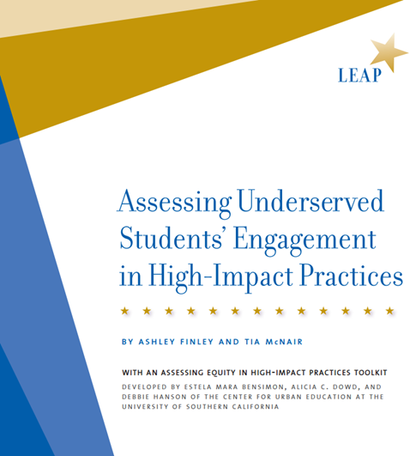
Equity and High Impact Practices in the context of Pathways
How do we integrate equity into the work of designing purposeful and effective HIP’s?
Equity as an impetus for structuring student experiences toward completion
Equity as a key reason for providing more structure and support
Particularly benefits first-generation and low income students
Eight Key Elements of HIP’S
High performance expectations
Significant investment of time and effort
Substantive interactions with faculty and peers
Experiences with diversity—Exposure to the unfamiliar
Frequent, timely, and constructive feedback
Opportunities to reflect and integrate learning
Relevance of learning through real-world application
Public demonstration of competence
Addressing equity and inclusive excellence requires clarity in language and goals, intentionality, and accountability

Slide 5
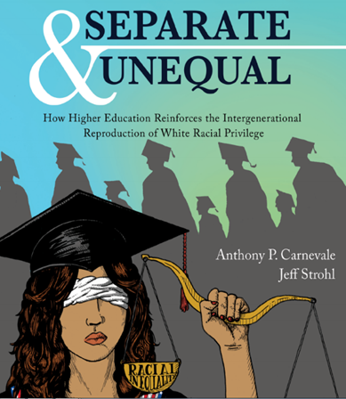
Equity and Access
Access is meaningful when education opportunities extends beyond enabling matriculation to encompass the chance to both excel while enrolled and to pursue a career unburdened by excessive debt (Glater, 2016).
Two critical determinants of meaningful access – Debt and Merit
Merit is such a powerful and compelling concept, especially at elite colleges and universities,
that it has been recognized by Supreme Court doctrine. Glater, 2016
Grutter v. Bollinger, 539 U. S. 306, and Gratz v. Bollinger, 539 U. S. 244
Compared with equally qualified white students, African American and Hispanic students not only have less access to post secondary education in general, but in addition less access to the 468 elite colleges and universities.
Carnevale and Strohl, 2013

Slide 6
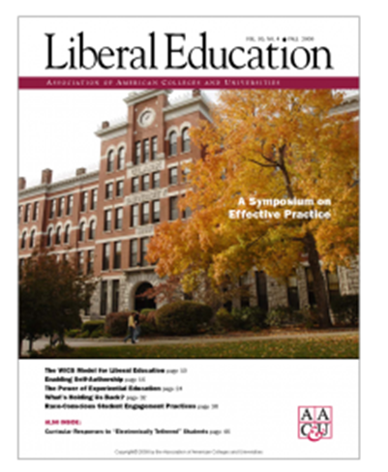
Equity Mindedness
Refers to the perspective or mode of thinking exhibited by practitioners who call attention to patterns of inequity in student outcomes. It also requires that practitioners are race-conscious and aware of the social and historical context of exclusionary practices in American Higher Education.
CENTER FOR URBAN EDUCATION, University of Southern California
Race Conscious Student Engagement Practices
Race-conscious student engagement can compel more racial minority students to reflect on powerful learning opportunities, institutional enablers of achievement, and outcomes-productive experiences. Harper 2009
Accepting institutional responsibility for minority student engagement and success
Attribute the presence of engagement inequities to institutional dysfunction
Replace confessions of inadequacy with committed efforts to remediate personal and professional shortcomings
Do not embrace “color-blindness”

Slide 7
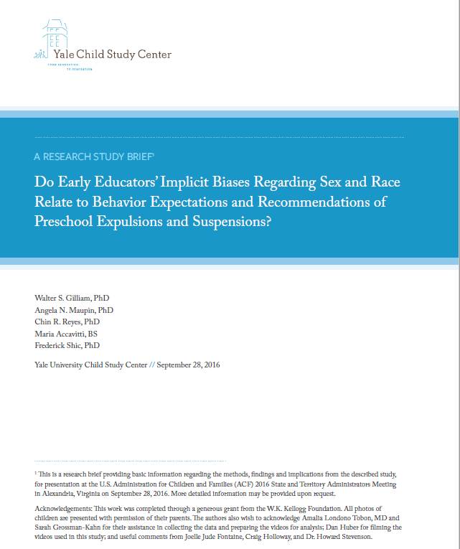
Implicit Bias – The cycle begins early in education…
“tendencies to view child behaviors differently based on race of the child may be a manifestation of more generalized implicit biases regarding race and criminal or delinquent behavior”
“teachers may be less likely to respond to empathy when a child of a race different to her own is exhibiting challenging behaviors”
“a vicious cycle over time exacerbating inequalities”
Okonofua, Watson & Eberhartdt (2016)
Decoupling

Slide 8
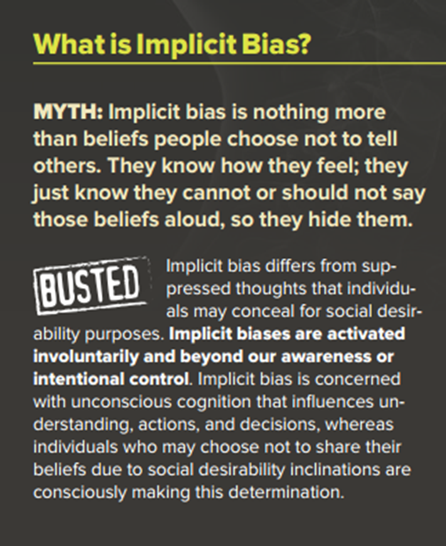
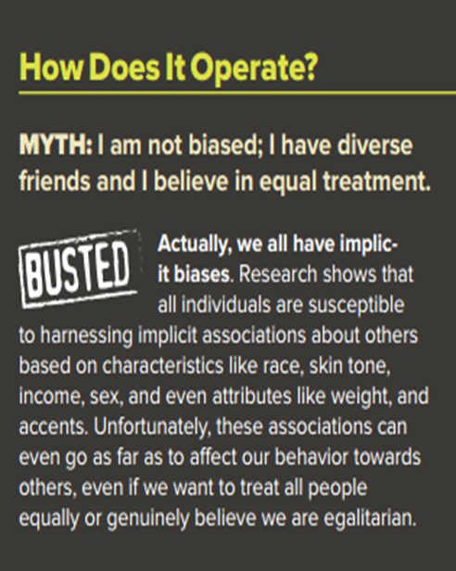
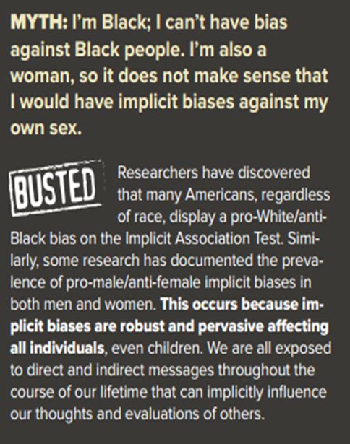
Implicit Bias – What it is…
Implicit means that we are either unaware of or mistaken about the source of the thought or feeling

Slide 9
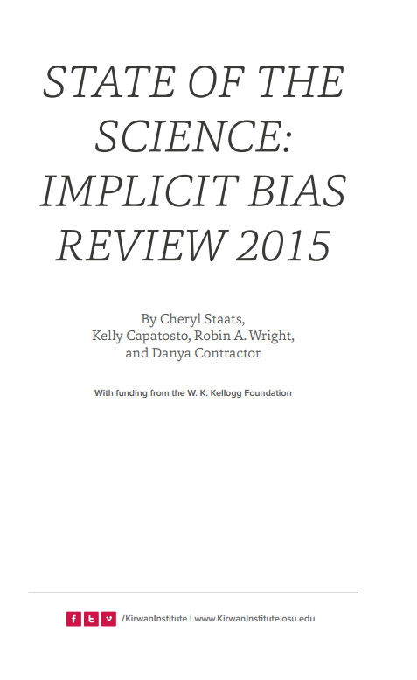
Implicit Bias – Understanding and accepting our biases…
Despite evidence of a pervasive pro-White bias, the authors noted teachers were able to mitigate these effects though culturally responsive teaching methods such as promoting mutual respect and resolving inter-ethnic conflicts.
By using these strategies, teachers were able to achieve a mastery-focused teaching approach (as opposed to the conventional performance-based method), even if they exhibited a pro-White bias.

Slide 10
This discourse on bias is only the tip of the iceberg,
and barely scratches the surface…
Race and Racism
Privilege
Critical Race Theory
Microaggressions
Color Blind Ideology

Slide 11
Common Themes in Equity and Access Research
Discourse around the influence and impact of race and racism in student engagement, development, and learning is scarce.
Race and Racism
“we cannot assume that those who benefit from a powerful system of privilege built on race will somehow learn to see or even want to see inequity and institutionalized systems of racism overnight. ” Hughes, 2014
Critical Race Theory
Critical race theory is a form of race-based oppositional scholarship, and openly acknowledges that racism is an endemic and permanent aspect of people of colors experience.
Microaggressions
Behaviors or statements that do not necessarily reflect malicious intent but which nevertheless can inflict insult or injury.
Color Blind Ideology
Entails opposition to racial categories and categorical social perception… extending to institutions and social policies
White Privilege
“is the notion that white subjects accrue advantages by virtue of being constructed as whites”
Leonardo, 2009

Slide 12
Race and Racism
Symbolic racism denies white America's implication in slavery and segregation, it correlates with resistance to the political demands of black people, and it minimizes or denies the importance of race in present-day questions of justice.
Claverie, 2017
Racism “ is so engrained in U.S. society that is seems natural and is often unrecognizable or invisible to most individuals” Ladson-Billings, 1998
“Whites now believe that anti-White bias is more prevalent than anti-Black bias”…“this emerging perspective is particularly notable because by nearly any metric—from employment to police treatment, loan rates to education—statistics continue to indicate drastically poorer outcomes for Black than White Americans”
Norton & Sommers, 2011
In its most destructive form, racism is a system of advantage based on race where institutions -- prisons, banks, corporations - wreak more havoc than bigoted individuals…
Loury, 2015

Slide 13
Critical Race Theory
Tenets of Critical Race Theory
Bell, 1995
The permanence of racism
That racism is an endemic and permanent aspect of people of colors experience.
Interest convergence theory
Grounded on the premise that people of color’s interest in achieving racial equality advances only when those interests “converge” with the interests of those in power. Thus people of color in the United States make significant, social, political and economic progress when their interests align with those in power and those interests serve to benefit both groups.
McCoy & Rodricks, 2015
Intersectionality
Racial identity and (racism) intersect with other subordinate identities (such as gender, class, religion, ability/disability, and sexual orientation) and forms of oppression (such as sexism, homophobia, etc.) to influence People’s of Colors lived experiences. Brayboy, 2005

Slide 14
Racial Microaggressions
Microagrresssive behavior and White privilege combine to create campus climate that are not exclusive.
Taxonomy of microaggressions (Sue, 2007)
Themes
Alien in one’s own land
Ascription of intelligence
Color blindness
Criminality assumption
Denial of individual racism
Myth of meritocracy
Pathologizing cultural values
Second class status
Environmental invalidation
These appear in three forms
Microassults – explicit racial degradation
Microinsults – deliberate but allow for anonymity
Microinvalidations – communication that exclude/negate feelings

Slide 15
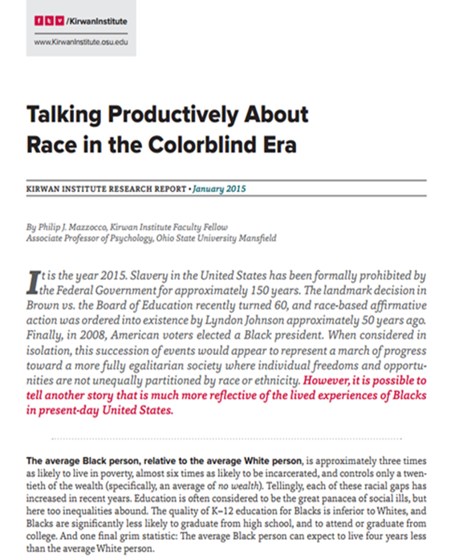
Colorblind ideology
Kirwan Institute Research Report, 2015
Racial colorblindness entails opposition to racial categories and categorical social perception.
Color-blind ideology has discouraged honest discussion about race, and the discourse on diversity rarely addresses historical contexts for current-day racial dynamics.
Further, many of us do not have a lot experience thinking very deeply about race, much less talking or teaching students about race and racism.
Four beliefs associated with Color-blind environments
Racial groups receive privileges based on merit
Most people do not care or pay attention to race
Patterns of social inequity are the result of cultural deficits of individuals
No systemic attention needs to be given to any existing inequities
http://www.whitenessproject.org/checkbox

Slide 16
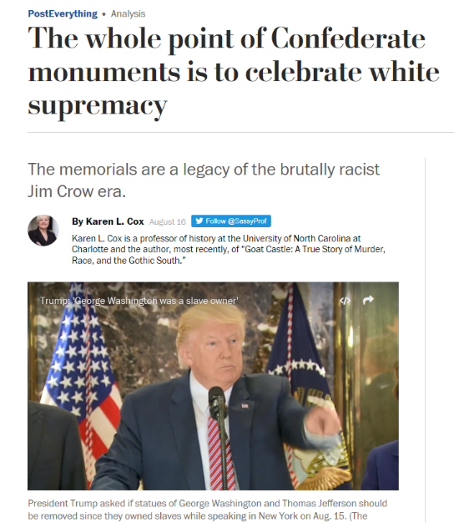
White Privilege
“Coming to terms with white privilege is not about blame, shame or guilt.” McIntosh, 1992
White ignorance is not only about “not knowing what one does not know”, but also involves “a passion for ignorance” when it comes to learning difficult knowledge that challenges ones moral self… Applebaum, 2008
“A racially cognizant sense of Whiteness encompasses an understanding of guilt, power and privilege yet avoids the paralysis and victim perspectives...”
Reason and Evans, 2007
“We live in a condition where racism thrives absent of racists.” Leonardo, 2009

Slide 17
Engaging in the equity imperative
Let’s then engage in ally work with those faculty, staff and administrators that
“have their feet in the worlds of both the dominant and the oppressed…They need to listen, speak up, or to absent the discussion…”Patton and Bondi, 2015

Slide 18
Understanding Ourselves:
Engaging in the equity imperative
Mark Williams, Ph.D.
Assistant Professor, Business Studies
The Community College of Baltimore County

